Slide 1
Computer Organization | Basic Computer Instructions
Notes:
https://www.youtube.com/watch?v=706aFmWa9ME

Slide 2
Computer instruction
A computer instruction is a set of commands that tells the computer hardware to perform a specific operation.
All CPUs have instruction sets that enable commands directing the CPU to switch the relevant transistors. The instructions tell the CPU to perform tasks. Some instructions are simple read, write and move commands that direct data to different hardware elements. For the designing of the basic computer we require certain computer commands that are called as computer instructions

Slide 3
instruction set architecture
It is the collection of machine language instructions that a particular processor understands and executes. The entire group of instructions that a processor supports
The format in which the computer instructions are to be written is defined by the instruction set architecture (ISA) of the computer. The instruction set architecture defines the set of instructions that are supported by the processor of the computer.
8086 has more than 20,000 instrcutions

Slide 4
types of instructions
Data transfer instructions
Data manipulation instructions
Program sequencing and control instructions
Input and output instructions

Slide 5
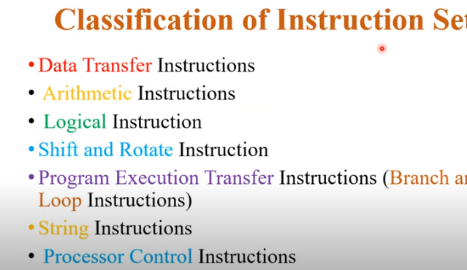
8086 classification

Slide 6


Slide 7
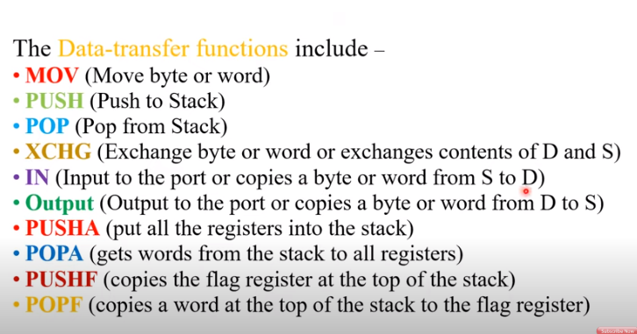

Slide 8
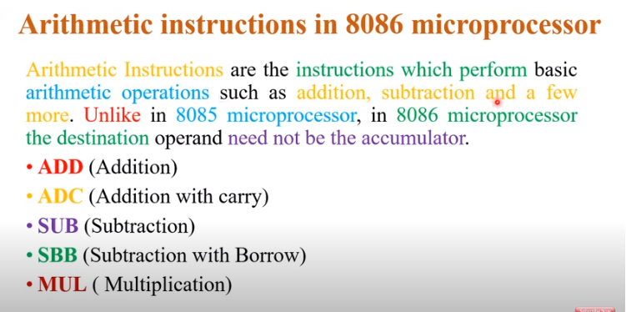

Slide 9
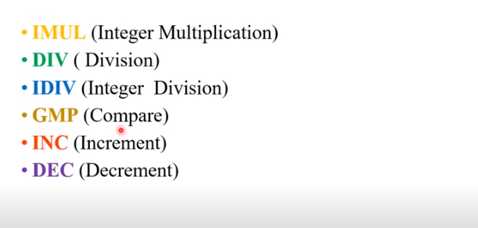

Slide 10
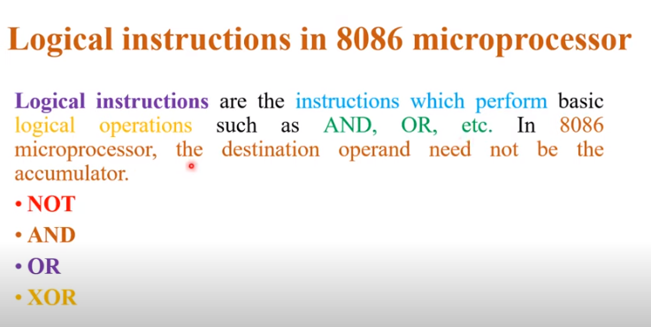

Slide 11
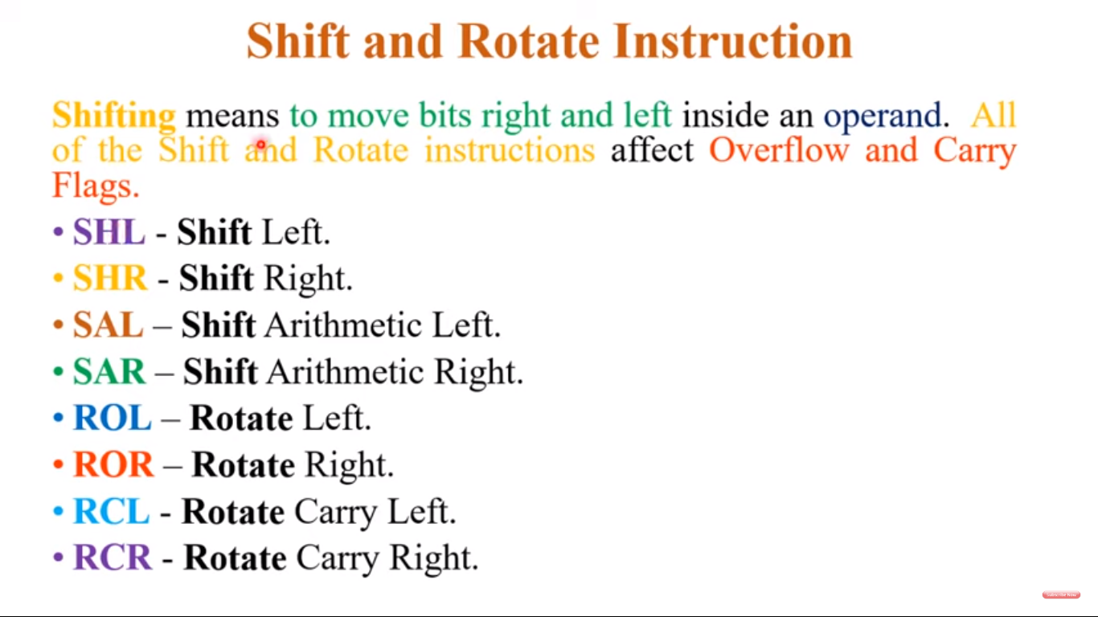

Slide 12
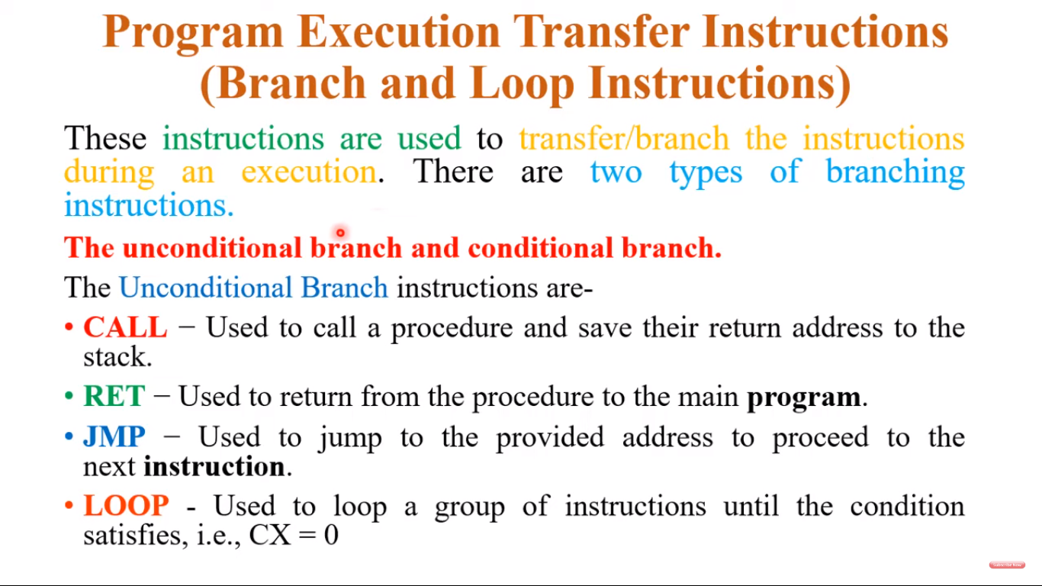

Slide 13
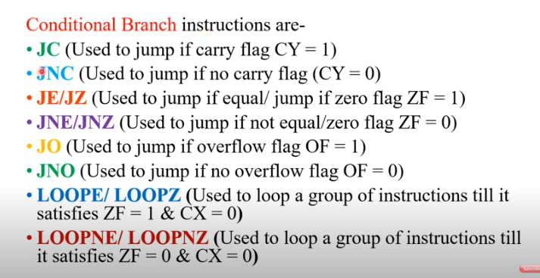

Slide 14
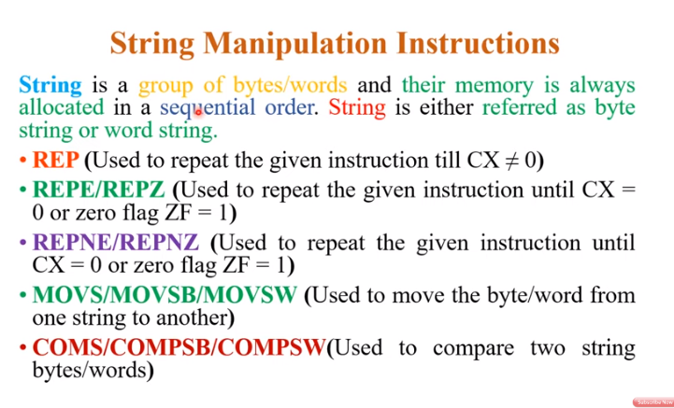

Slide 15
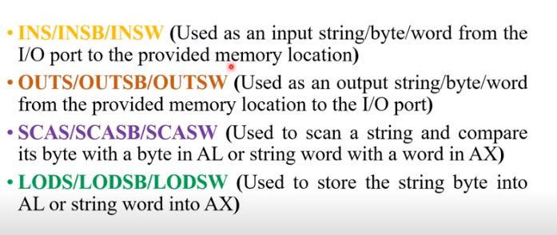

Slide 16
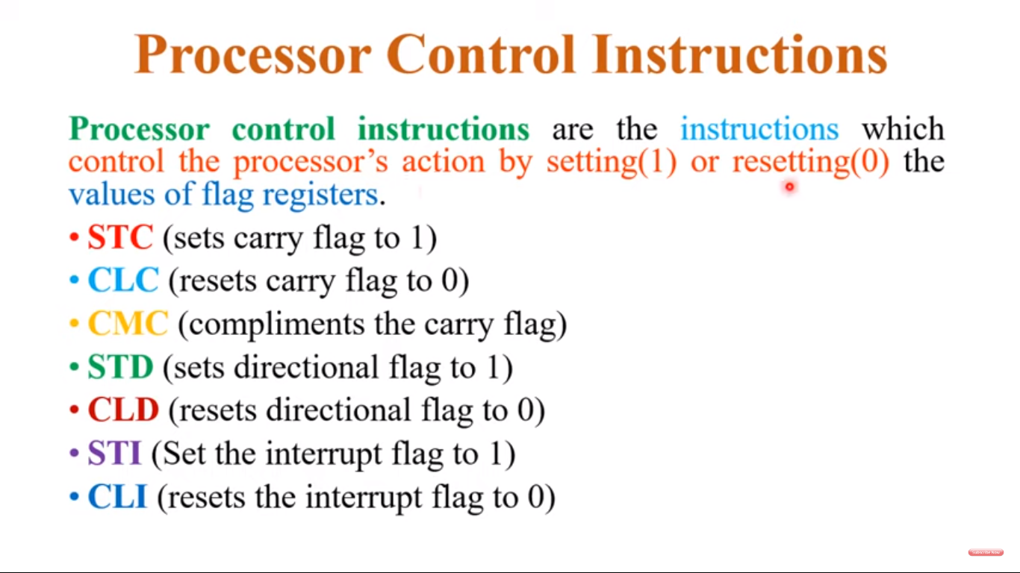

Slide 17
Types of instructions
Based on the functionality, the basic computer instructions can be classified into the following three major types:
Memory Reference Instructions
Register Reference Instructions
Input/Output Instructions

Slide 18
Memory Reference Instructions
The memory reference instructions are used for manipulation of data stored in the computer memory. Memory reference instructions enable the computer’s CPU to access and process the data stored in a specific memory address(operands are stored in memory).
Therefore, memory reference instructions provide a mean for writing data to memory or reading data from memory.
The format of memory reference instruction consists of three parts namely, opcode (operation code), operands, and addressing mode. Where, opcode represents the operation to be performed, while the operand represents the memory address where the data is stored.

Slide 19

Format of memory ref inst:
A memory reference instruction typically uses 12 bits to specify a memory address, 3 bits to specify the opcode, and 1 bit to identify the addressing mode.

Slide 20

The basic computer has 16-bit instruction register (IR) which can denote either memory reference or register reference or input-output instruction.
Memory Reference – These instructions refer to memory address as an operand. The other operand is always accumulator. Specifies 12-bit address, 3-bit opcode (other than 111) and 1-bit addressing mode for direct and indirect addressing. EG mov ax, [572]
Notes:
If I=0 direct addressing mode
I=1 indirect addressing mode

Slide 21
eg
Example – IR register contains = 0001XXXXXXXXXXXX, i.e. ADD after fetching and
decoding of instruction we find out that it is a memory reference
instruction for ADD operation.
Hence, DR ← M[AR] AC ← AC + DR, SC ← 0
Notes:
AR= address register

Slide 22
The memory reference instructions are further classified into the following two types −
Store Instruction − The store instruction is used to write data into the memory.
Load Instruction − This instruction is used to retrieve data stored in the memory.
The execution process of memory reference instruction is explained here.
Firstly, the computer’s CPU uses the program counter to fetch the instruction from the memory. Then, this instruction is decoded to determine the opcode and operands. If the opcode is for load instruction, the CPU accesses the memory location of the provided memory address to retrieve the stored data. If the opcode is for store instruction, the CPU writes the data into the provided memory address.

Slide 23
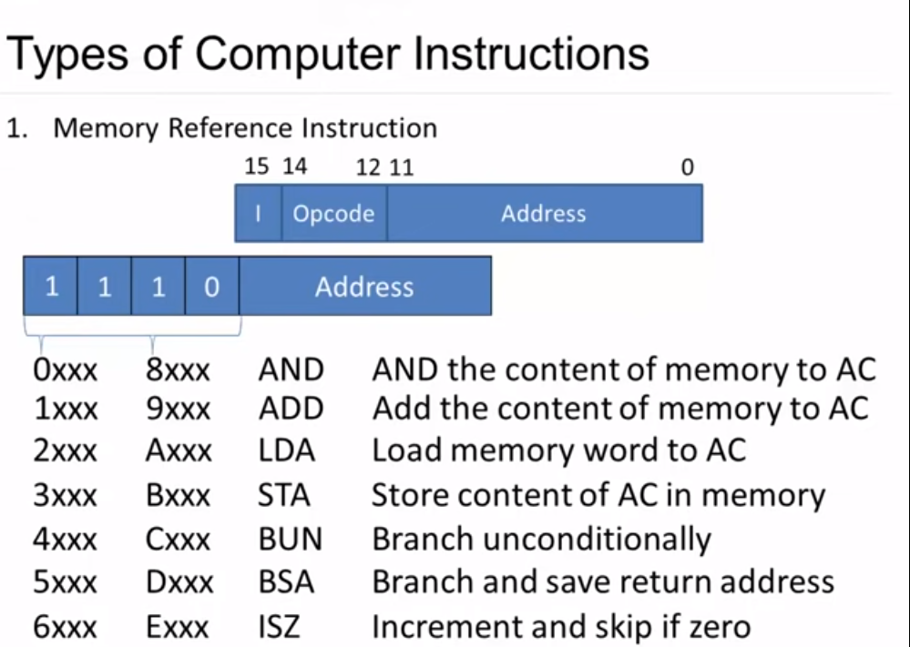

Slide 24
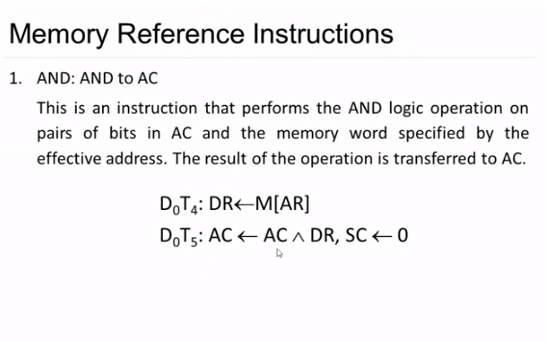

Slide 25
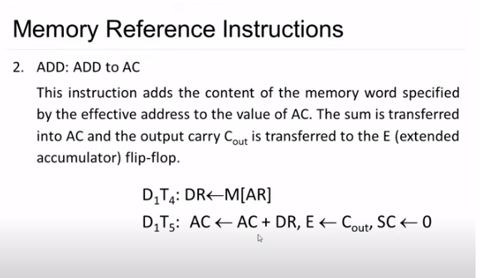

Slide 26
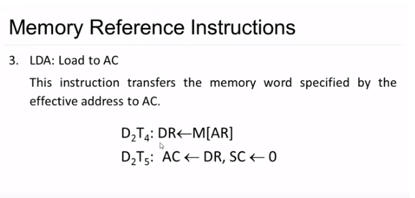

Slide 27
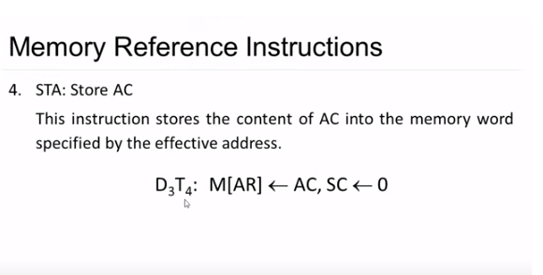

Slide 28


Slide 29

Notes:
https://www.youtube.com/watch?v=O8yHtoqIq0Y

Slide 30


Slide 31
Register reference instruction
Register reference instruction is a computer instruction that operates on the data stored in the registers instead of memory addresses. Hence, the register reference instructions are primarily used for manipulation of data stored in the registers of the processors of a computer.
Similar to memory reference instructions, register reference instructions can also perform operation like data manipulation, arithmetic operations, logical operations, etc. on the data stored in registers. In comparison to memory reference instructions, the register reference instructions are faster in execution.
Register reference instruction consists of two parts namely, opcode, and register operation. The opcode (operational code) represents the operation to be performed.

Slide 32

Register Reference Instructions
Register Reference – These instructions perform operations on registers rather than memory addresses. The IR(14 – 12) is 111 (differentiates it from memory reference) and IR(15) is 0 (differentiates it from input/output instructions). The rest 12 bits specify register operation.

Slide 33

In computer organization, the register reference instructions are determined by their opcode 111 with a 0 at the left most of the instruction. In the case of register reference instructions, there is no need of an operand from memory because it uses additional 12 bits to identify the operation to be implemented.

Slide 34
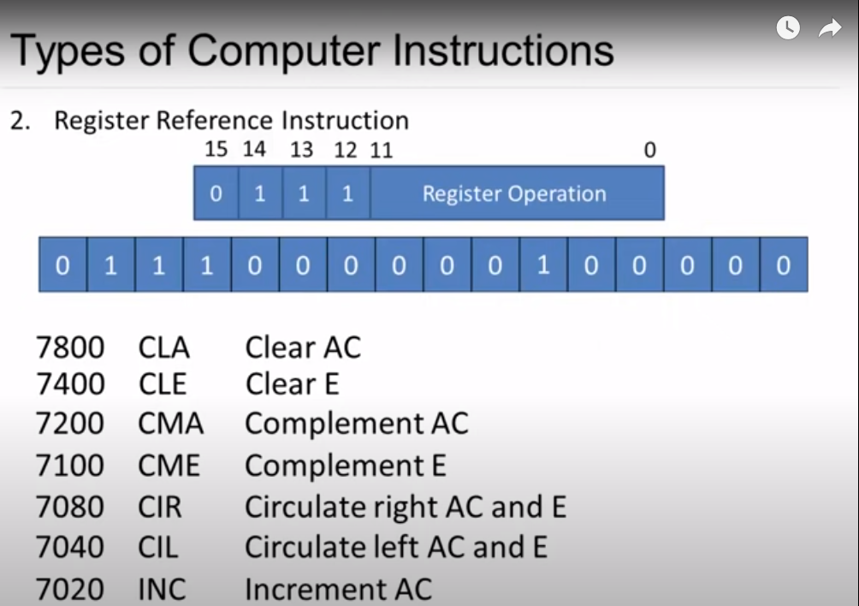

Slide 35
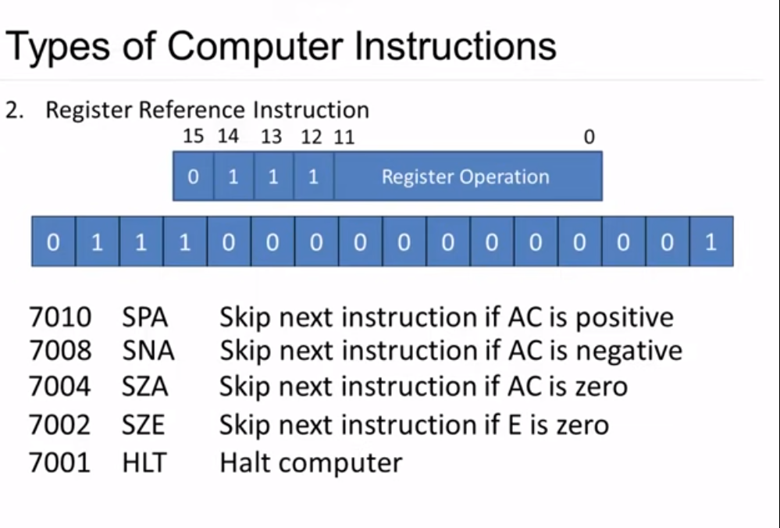

Slide 36
Example – IR register contains = 0111001000000000, i.e. CMA after fetch and decode
cycle we find out that it is a register reference instruction for complement
accumulator.
Hence, AC ← ~AC
Input/Output – These instructions are for communication between computer
and outside environment. The IR(14 – 12) is 111
(differentiates it from memory reference) and IR(15) is 1 (differentiates it
from register reference instructions). The rest 12 bits specify I/O operation.

Slide 37
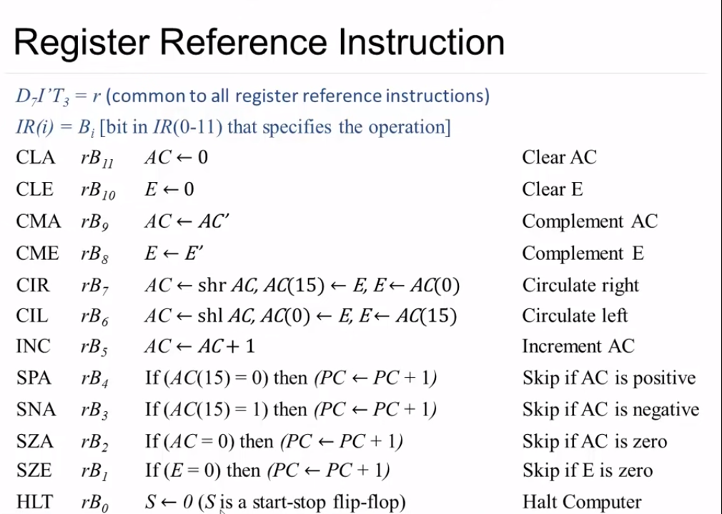

Slide 38
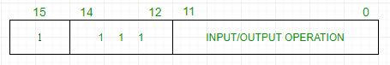
Input-Output Instructions

Slide 39

The input-output instructions enable the data transfer from and to input and output devices like keyboard, memory disks, monitor, etc. With the help of input-output instructions, the computer system receives data input from users and sends output to users.
Similar to register reference instructions, the input-output instructions also do not require a memory reference. It is identified by the opcode 111 with a 1 at the leftmost of the instruction. The rest 12-bits are used to represent the type of input/output operation to be performed.

Slide 40
eg
Example – IR register contains = 1111100000000000, i.e. INP after fetch and decode cycle we find out that it is an input/output instruction for inputing character. Hence, INPUT character from peripheral device.
The set of instructions incorporated in16 bit IR register are:
Arithmetic, logical and shift instructions (and, add, complement, circulate left, right, etc)
To move information to and from memory (store the accumulator, load the accumulator)
Program control instructions with status conditions (branch, skip)
Input output instructions (input character, output character)

Slide 41
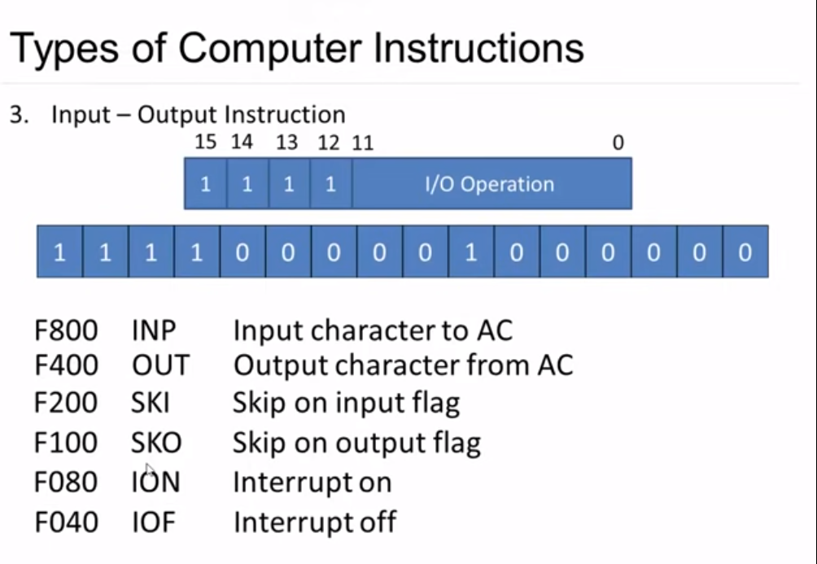

Slide 42
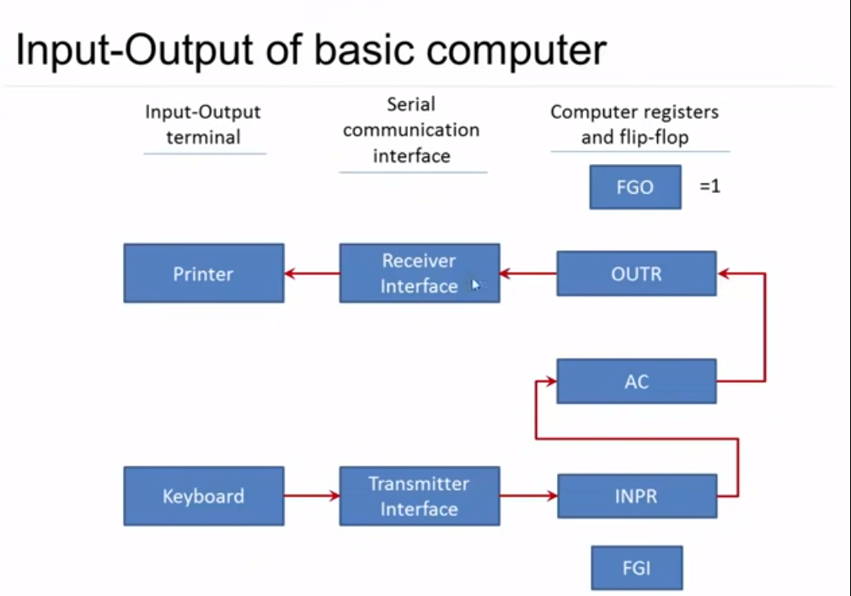
Notes:
FGI=1 receive vAlue
FGO=0 send command to output device
FGO=1 receive output

Slide 43
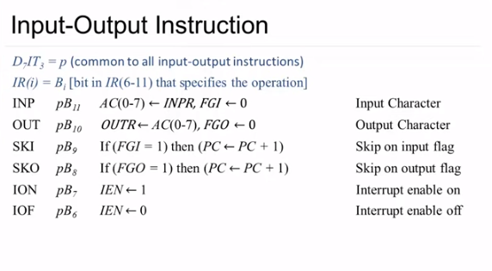

Slide 44
Computer Organization | RISC and CISC
Reduced Instruction Set Architecture (RISC) – The main idea behind this is to make hardware simpler by using an instruction set composed of a few basic steps for loading, evaluating, and storing operations just like a load command will load data, a store command will store the data.
Complex Instruction Set Architecture (CISC) – The main idea is that a single instruction will do all loading, evaluating, and storing operations just like a multiplication command will do stuff like loading data, evaluating, and storing it, hence it’s complex.
Both approaches try to increase the CPU performance
RISC: Reduce the cycles per instruction at the cost of the number of instructions per program.
CISC: The CISC approach attempts to minimize the number of instructions per program but at the cost of an increase in the number of cycles per instruction.

Slide 45
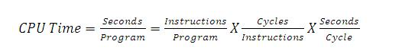

Slide 46
Earlier when programming was done using assembly language, a need was felt to make instruction do more tasks because programming in assembly was tedious and error-prone due to which CISC architecture evolved but with the uprise of high-level language dependency on assembly reduced RISC architecture prevailed.
Characteristic of RISC –
Simpler instruction, hence simple instruction decoding.
Instruction comes undersize of one word.
Instruction takes a single clock cycle to get executed.
More general-purpose registers.
Simple Addressing Modes.
Fewer Data types.
A pipeline can be achieved.

Slide 47
Characteristic of CISC –
Complex instruction, hence complex instruction decoding.
Instructions are larger than one-word size.
Instruction may take more than a single clock cycle to get executed.
Less number of general-purpose registers as operations get performed in memory itself.
Complex Addressing Modes.
More Data types.
Example – Suppose we have to add two 8-bit numbers:
CISC approach: There will be a single command or instruction for this like ADD which will perform the task.
RISC approach: Here programmer will write the first load command to load data in registers then it will use a suitable operator and then it will store the result in the desired location.
So, add operation is divided into parts i.e. load, operate, store due to which RISC programs are longer and require more memory to get stored but require fewer transistors due to less complex command.

Slide 48
Difference –
RISC | CISC
Focus on software | Focus on hardware
Uses only Hardwired control unit | Uses both hardwired and microprogrammed control unit
Transistors are used for more registers | Transistors are used for storing complex Instructions
Fixed sized instructions | Variable sized instructions
Can perform only Register to Register Arithmetic operations | Can perform REG to REG or REG to MEM or MEM to MEM
Requires more number of registers | Requires less number of registers
Code size is large | Code size is small
An instruction executed in a single clock cycle | Instruction takes more than one clock cycle
An instruction fit in one word | Instructions are larger than the size of one word

